Slide 1

Web Designing Project
Department Of Information Technology
Submitted By :- Yash Gupta
Kumari Ritika
Manav Taygi
Udit
Submitted To :- Mrs. Prachi Chhabra

Slide 2
Acknowledgement
We would like to express our special thanks of gratitude to our teacher Mrs. Prachi Chhabra Ma’am who gave us the golden opportunity to do this wonderful project on the topic (OTT platform), which also helped us in doing a lot of Research and we came to know about so many new things. We are really thankful to her.

Slide 3

CONTENT
Objective
Introduction To Web Designing
Introduction To My OTT Platform
Language Used
Future Working Plan
Conclusion
Reference

Slide 4
OBJECTIVE
To learn introductory Web Designing for the Web Development for Restaurant website using HTML, CSS, JAVA SCRIPT.
It includes developing simple design that could run on server.
To gain more more knowledge in field of Design.

Slide 5
INTRODUCTION TO WEB DESIGNING
Web design is the visual aesthetics and page layout of a website.
It goes hand-in-hand with web development in the creation of a static website or dynamic web application.
No matter whether you want to make static websites or dynamic web applications, design is an important part of the process.

Slide 6



INTRODUCTION TO OTT PLATFORM
Project : OTT (Over The Top) Channel for all
OTT is a means of providing television and film content over the internet at the request and to suit the requirements of the individual consumer. The term itself stands for “over-the-top”, which implies that a content provider is going over the top of existing internet services.

Slide 7
Binge
Binge is a free OTT platform for all , where people can easily access to all the latest shows , movies , web series and many more.
All the latest movies are uploaded on Binge .
Currently Binge is free for all but as we grow our website we are going to add subscription to it . But till then it is easily
Accessable
Link to Binge :
https://yashgupta1109.github.io/Hotstar/index.html

Slide 8
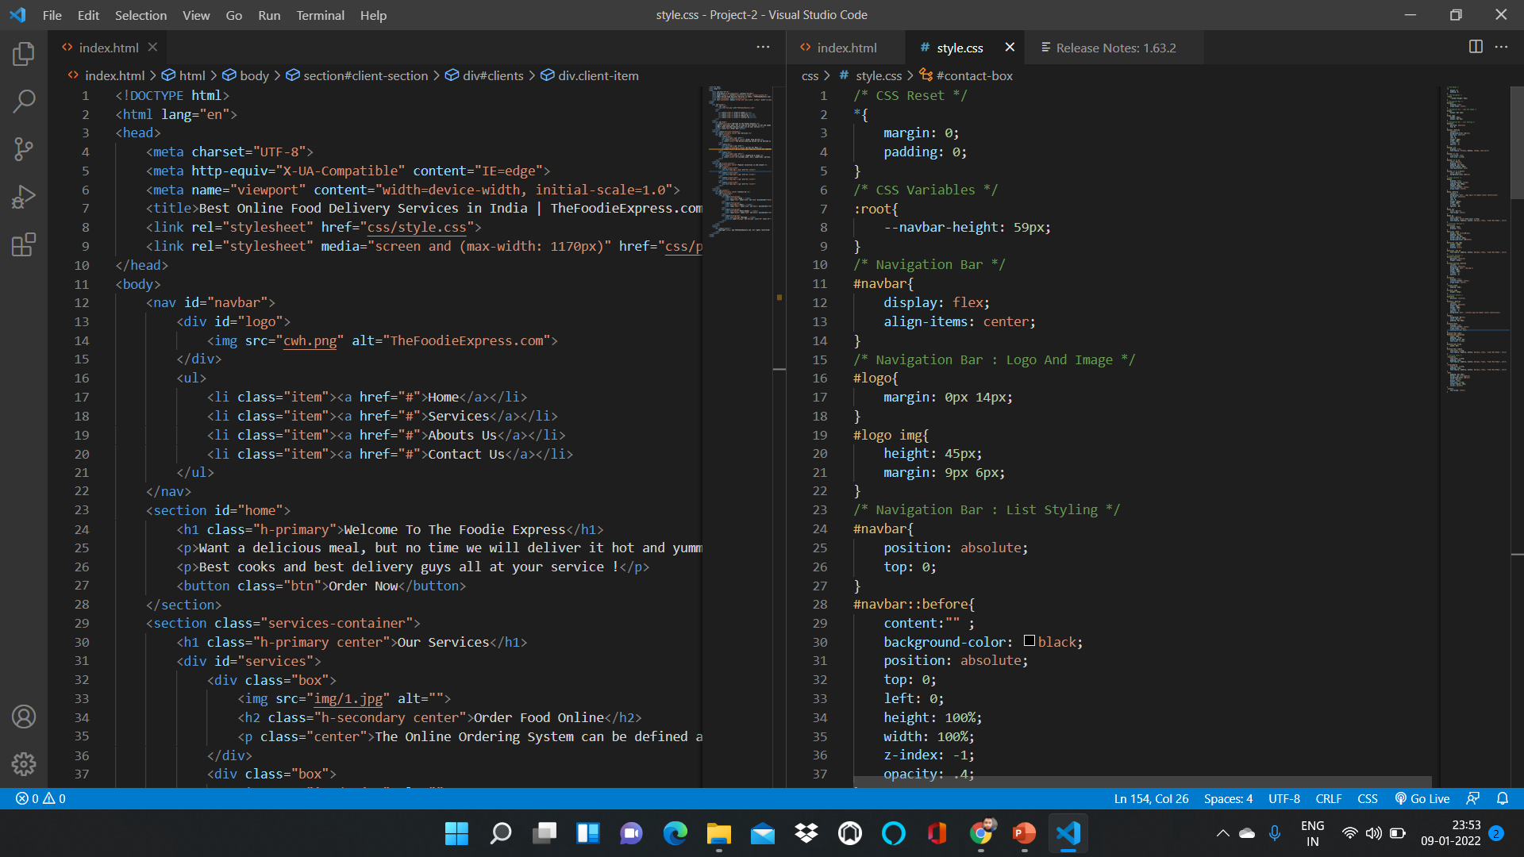
VISUAL STUDIO INTERFACE

Slide 9



LANGUAGE USED
HTML :- The HyperText Markup Language, or HTML is the standard markup language for documents designed to be displayed in a web browser. It can be assisted by technologies such as Cascading Style Sheets (CSS) and scripting languages such as JavaScript.
CSS :- Cascading Style Sheets (CSS) is a style sheet language used for describing the presentation of a document written in a markup language such as HTML.^{[1]} CSS is a cornerstone technology of the World Wide Web, alongside HTML and JavaScript.
JavaScript ] often abbreviated JS, is a programming language that is one of the core technologies of the World Wide Web, alongside HTML and CSS.

Slide 10
FUTURE WORKING PLAN
As new ides comes in, I am going to implement them and provide the update soon.
In future I am going to add more features as gaining more knowledge.
I am going to Host my web page on Server after few modifications.

Slide 11
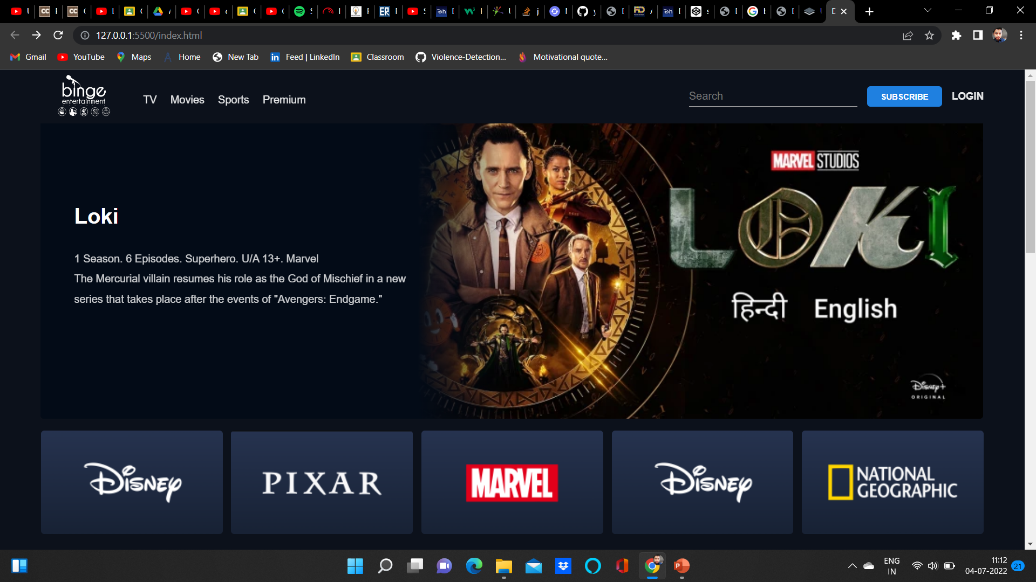
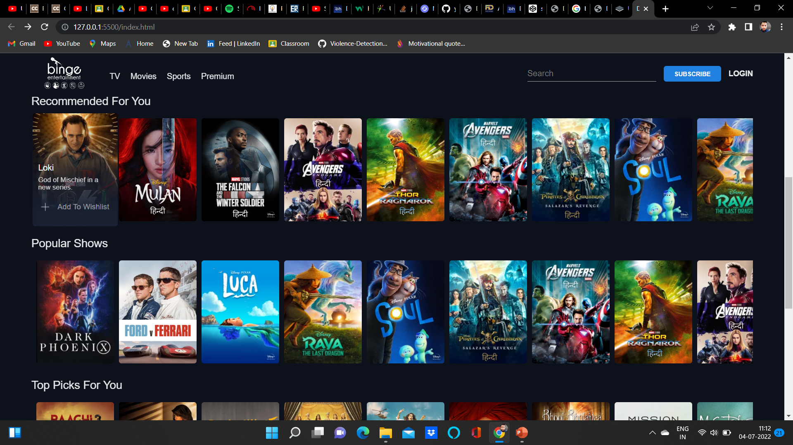
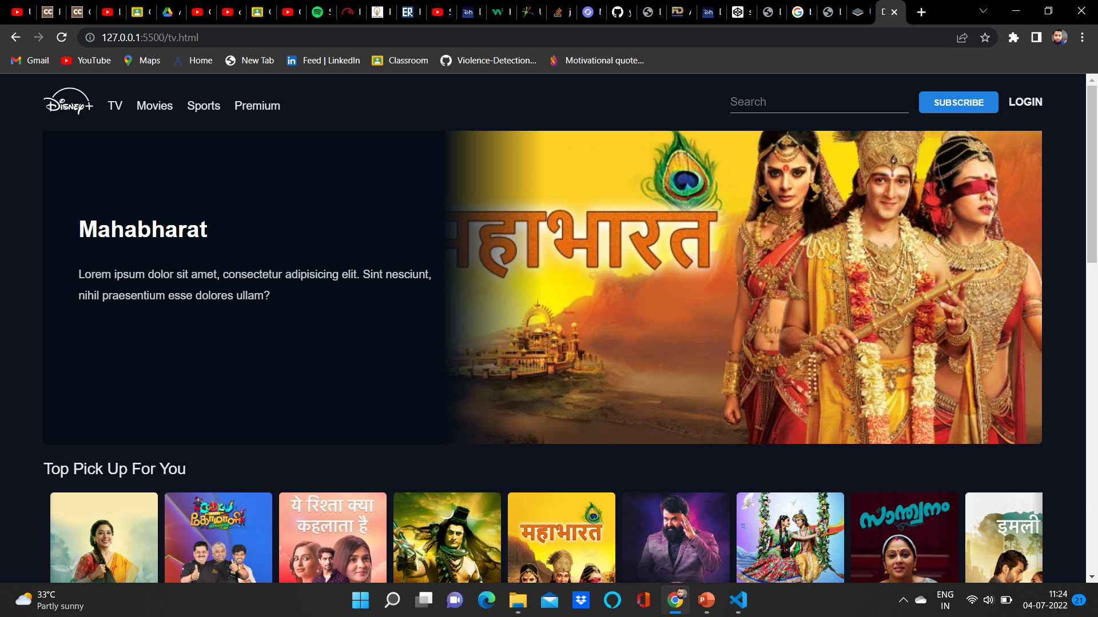
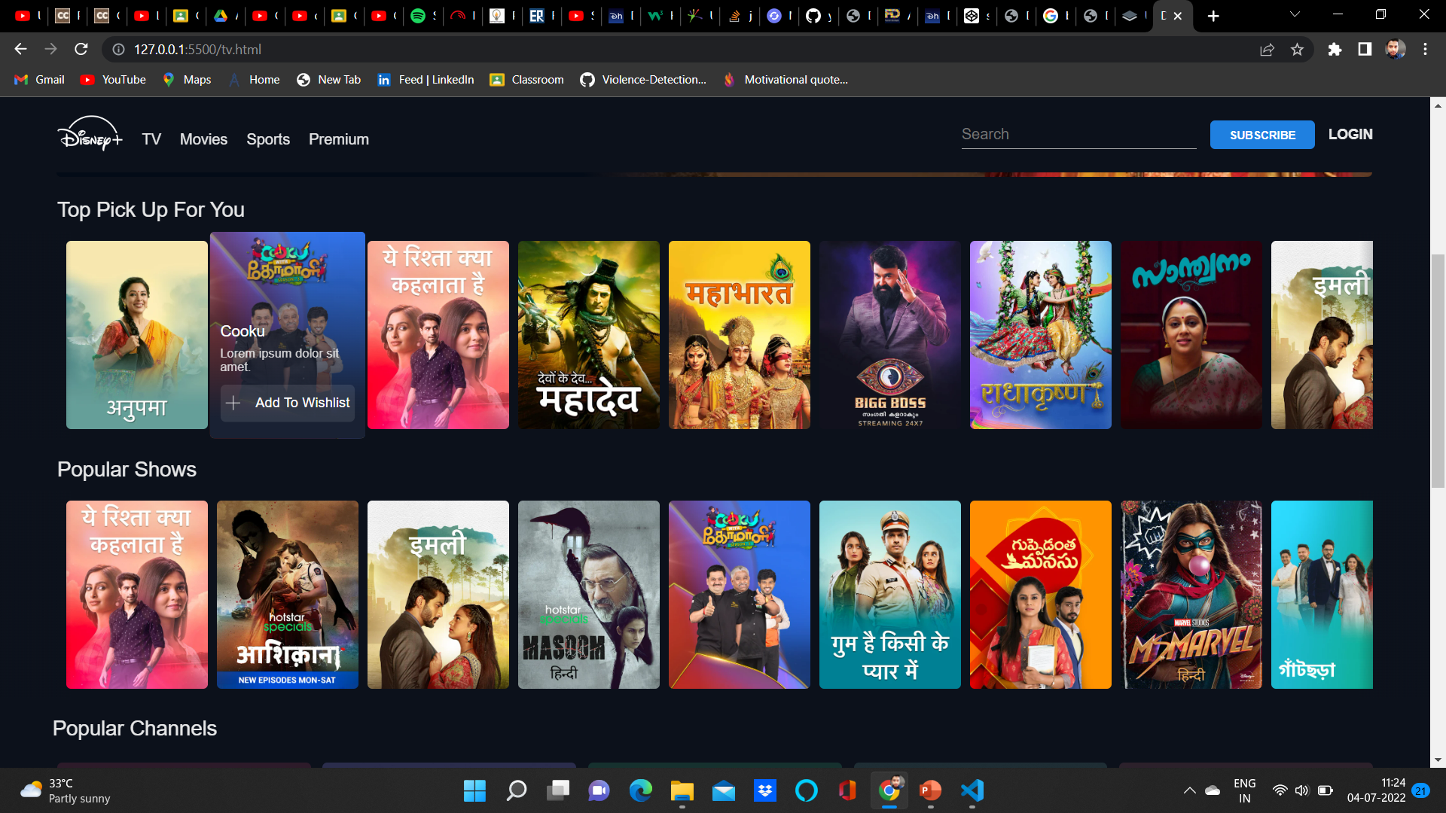
Screenshots Of Project

Slide 12
CONCLUSION
The purpose and objective of web project is achieved. Web page designing is easy and in an aesthetic form. Flexibility in designing makes user explore their imagination and thus, even a novice user can dream and accomplish their of web page designing.

Slide 13
REFERENCE
https://www.google.com
https://www.youtube.com
https://www.quora.com

Slide 14
Thank You !!

